Slide 1
Java OOPs Concepts
Instructor :Prashant Mishra
BIAS Bhimtal

Slide 2
Object-Oriented Programming is a paradigm that provides many concepts, such as inheritance, data binding, polymorphism, etc.
Simula is considered the first object-oriented programming language. The programming paradigm where everything is represented as an object is known as a truly object-oriented programming language.
Smalltalk is considered the first truly object-oriented programming language.
The popular object-oriented languages are Java, C#, PHP, Python, C++, etc.
The main aim of object-oriented programming is to implement real-world entities, for example, object, classes, abstraction, inheritance, polymorphism, etc.

Slide 3
Pure Object Oriented Language
A language is called PURE object oriented if It contains only objects and classes. In it we do access everything through 'Message Passing'. A Pure Object Oriented Language has these following characteristics, along with four basic characteristics of Object Oriented Programming.
All predefined DATA Types are objects.
All user defined DATA Types are objects.
Data Hiding
Encapsulation
Inheritance
Polymorphism
Abstraction
on the other hand it will not called a 'Pure Object Oriented Language' if it will contain these properties:
Primitive Data Type ex: int, long etc.
Wrapper Class
ex: JAVA is not a 'Pure Object Oriented Language' as in contains Primitive Data Types (int, long, double) and wrapper class.

Slide 4
Fully Object Oriented Language
A language is called FULLY object oriented if it contains all the fundamental features of object oriented programming and it can have primitive data types or not. OO properties are:
Encapsulation
Inheritance
Polymorphism
Abstraction
Some of fully object oriented languages are, as follows:
JAVA
C#
Visual Basic
C++

Slide 5
Object Based Languages
Object based languages supports the usage of object and encapsulation.
They does not support inheritance or, polymorphism or, both.
Object based languages does not supports built-in objects.
Javascript, VB are the examples of object bases languages.

Slide 6
Object Oriented Languages
Object Oriented Languages supports all the features of Oops including inheritance and polymorphism.
They support built-in objects.
C#, Java, VB. Net are the examples of object oriented languages.

Slide 7
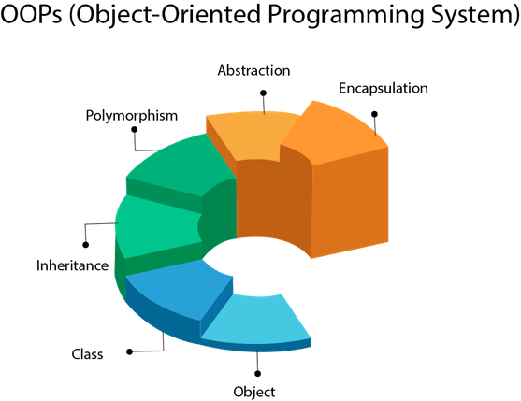

Slide 8
Object means a real-world entity such as a pen, chair, table, computer, watch, etc. Object-Oriented Programming is a methodology or paradigm to design a program using classes and objects. It simplifies software development and maintenance by providing some concepts:
Object
Class
Inheritance
Polymorphism
Abstraction
Encapsulation
Apart from these concepts, there are some other terms which are used in Object-Oriented design:
Coupling
Cohesion
Association
Aggregation
Composition

Slide 9
Object
Any entity that has state and behavior is known as an object. For example, a chair, pen, table, keyboard, bike, etc. It can be physical or logical.
An Object can be defined as an instance of a class. An object contains an address and takes up some space in memory. Objects can communicate without knowing the details of each other's data or code. The only necessary thing is the type of message accepted and the type of response returned by the objects.
Example: A dog is an object because it has states like color, name, breed, etc. as well as behaviors like wagging the tail, barking, eating, etc.

Slide 10
Class
Collection of objects is called class. It is a logical entity.
A class can also be defined as a blueprint from which you can create an individual object. Class doesn't consume any space.

Slide 11
Inheritance
When one object acquires all the properties and behaviors of a parent object, it is known as inheritance. It provides code reusability. It is used to achieve runtime polymorphism.

Slide 12
Polymorphism
If one task is performed in different ways, it is known as polymorphism. For example: to convince the customer differently, to draw something, for example, shape, triangle, rectangle, etc.
In Java, we use method overloading and method overriding to achieve polymorphism.
Another example can be to speak something; for example, a cat speaks meow, dog barks woof, etc.

Slide 13
Abstraction
Hiding internal details and showing functionality is known as abstraction. For example phone call, we don't know the internal processing.
In Java, we use abstract class and interface to achieve abstraction.

Slide 14
Encapsulation
Binding (or wrapping) code and data together into a single unit are known as encapsulation. For example, a capsule, it is wrapped with different medicines.
A java class is the example of encapsulation. Java bean is the fully encapsulated class because all the data members are private here.

Slide 15
Coupling
Coupling refers to the knowledge or information or dependency of another class. It arises when classes are aware of each other. If a class has the details information of another class, there is strong coupling. In Java, we use private, protected, and public modifiers to display the visibility level of a class, method, and field. You can use interfaces for the weaker coupling because there is no concrete implementation.

Slide 16
Cohesion
Cohesion refers to the level of a component which performs a single well-defined task. A single well-defined task is done by a highly cohesive method. The weakly cohesive method will split the task into separate parts. The java.io package is a highly cohesive package because it has I/O related classes and interface. However, the java.util package is a weakly cohesive package because it has unrelated classes and interfaces.

Slide 17
Association
Association represents the relationship between the objects. Here, one object can be associated with one object or many objects. There can be four types of association between the objects:
One to One
One to Many
Many to One, and
Many to Many
Let's understand the relationship with real-time examples. For example, One country can have one prime minister (one to one), and a prime minister can have many ministers (one to many). Also, many MP's can have one prime minister (many to one), and many ministers can have many departments (many to many).
Association can be unidirectional or bidirectional.

Slide 18
Aggregation
Aggregation is a way to achieve Association. Aggregation represents the relationship where one object contains other objects as a part of its state. It represents the weak relationship between objects. It is also termed as a has-a relationship in Java. Like, inheritance represents the is-a relationship. It is another way to reuse objects.

Slide 19
Composition
The composition is also a way to achieve Association. The composition represents the relationship where one object contains other objects as a part of its state. There is a strong relationship between the containing object and the dependent object. It is the state where containing objects do not have an independent existence. If you delete the parent object, all the child objects will be deleted automatically.

Slide 20
Java Naming conventions
Java naming convention is a rule to follow as you decide what to name your identifiers such as class, package, variable, constant, method, etc.
But, it is not forced to follow. So, it is known as convention not rule. These conventions are suggested by several Java communities such as Sun Microsystems and Netscape.
All the classes, interfaces, packages, methods and fields of Java programming language are given according to the Java naming convention. If you fail to follow these conventions, it may generate confusion or erroneous code
Advantage of naming conventions in java
By using standard Java naming conventions, you make your code easier to read for yourself and other programmers. Readability of Java program is very important. It indicates that less time is spent to figure out what the code does.

Slide 21
key rules that must be followed by every identifier:
The name must not contain any white spaces.
The name should not start with special characters like & (ampersand), $ (dollar), _ (underscore).

Slide 22
some other rules that should be followed by identifiers.
Class
It should start with the uppercase letter.
It should be a noun such as Color, Button, System, Thread, etc.
Use appropriate words, instead of acronyms.
Example: -
public class Employee
{
//code snippet
}
Interface
It should start with the uppercase letter.
It should be an adjective such as Runnable, Remote, ActionListener.
Use appropriate words, instead of acronyms.
Example: -
interface Printable
{
//code snippet
}

Slide 23
Method
It should start with lowercase letter.
It should be a verb such as main(), print(), println().
If the name contains multiple words, start it with a lowercase letter followed by an uppercase letter such as actionPerformed().
Example:-
class Employee
{
//method
void draw()
{
//code snippet
}
}

Slide 24
Variable
It should start with a lowercase letter such as id, name.
It should not start with the special characters like & (ampersand), $ (dollar), _ (underscore).
If the name contains multiple words, start it with the lowercase letter followed by an uppercase letter such as firstName, lastName.
Avoid using one-character variables such as x, y, z.
Example :-
class Employee
{
//variable
int id;
//code snippet
}

Slide 25
Package
It should be a lowercase letter such as java, lang.
If the name contains multiple words, it should be separated by dots (.) such as java.util, java.lang.
Example :-
package com.javatpoint; //package
class Employee
{
//code snippet
}

Slide 26
Constant
It should be in uppercase letters such as RED, YELLOW.
If the name contains multiple words, it should be separated by an underscore(_) such as MAX_PRIORITY.
It may contain digits but not as the first letter.
Example :-
class Employee
{
//constant
static final int MIN_AGE = 18;
//code snippet
}

Slide 27
CamelCase in java naming conventions
Java follows camel-case syntax for naming the class, interface, method, and variable.
If the name is combined with two words, the second word will start with uppercase letter always such as actionPerformed(), firstName, ActionEvent, ActionListener, etc.

Slide 28
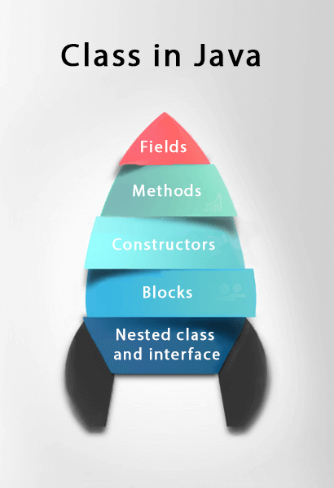
What is a class in Java
A class is a group of objects which have common properties. It is a template or blueprint from which objects are created. It is a logical entity. It can't be physical.
A class in Java can contain:
Fields
Methods
Constructors
Blocks
Nested class and interface

Slide 29
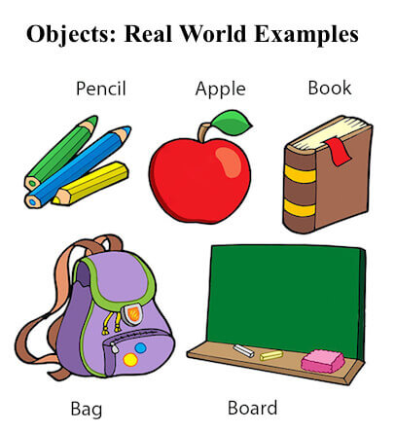
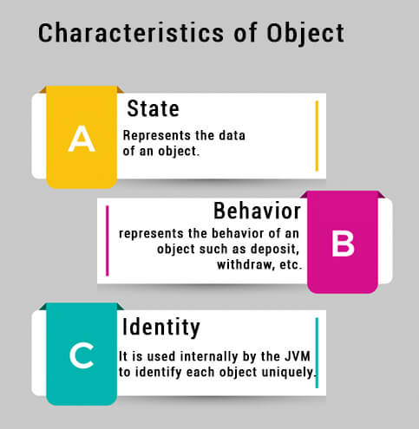
What is an object in Java
An entity that has state and behavior is known as an object e.g., chair, bike, marker, pen, table, car, etc. It can be physical or logical (tangible and intangible). The example of an intangible object is the banking system.
An object is an instance of a class.

Slide 30
Method in Java
In Java, a method is like a function which is used to expose the behavior of an object.
Advantage of Method
Code Reusability
Code Optimization

Slide 31
new keyword in Java
The new keyword is used to allocate memory at runtime. All objects get memory in Heap memory area.

Slide 32
Defining a class
A class is a user defined data type that serve to define its properties .
Once the class is defined we can create “variables” of that type using declaration that are similar to the basic type declaration .
In java these variables are termed as instance of the classes ,which are actual objects.

Slide 33
The basic form of class declaration is as below:
class classname [extends superclass]
{
[variables declarations;]
[method declarations;]
}

Slide 34
Adding variables
class Rectangle
{
int length ;
int width ;
}

Slide 35
Adding method
The general form of method declaration is :
type mehodname (parameter list)
{
method body;
}
Method declarations has four basic parts
Method name
Returns type
Parameter list
The body of the method

Slide 36
class Rectangle
{
int length ;
int width ;
void getdata(int x,int y)
{
length =x;
width = y;
}
}

Slide 37
class Rectangle
{
int length ;
int width ;
void getdata(int x,int y)
{
length=x;
width = y;
}
int rectArea()
{
int area = length*width;
return(area);
}
}

Slide 38
Creating objects
Objects in java are created using the new operator .
The new operator creates an objects of the specified class and returns a reference to that objects.
Ex.
Rectangle rect1; //declare
rect1 = new rectangle(); //instantiate
The method rectangle is the default constructor of the class .we can create any no. of objects of rectangle

Slide 39
Accessing class member
Objectname.variable name
Objectname.methodname(parameter-list) ;
rect1.length =15

Slide 40
illustration of class and object
class Rect
{
int length;
int width;
void getdata(int x,int y)
{
length=x;
width=y;
}
int rectArea()
{
int area=length*width;
return(area);
}
}
class RectangleArea
{
public static void main(String[]args)
{
int area1,area2;
Rect rect1=new Rect();
Rect rect2=new Rect();
rect1.length = 1;
rect1.width = 2;
area1=rect1.length*rect1.width;
rect2.getdata(5,10);
area2=rect2.rectArea();
System.out.println("area1="+area1);
System.out.println("area2="+area2);
}
}

Slide 41
Object and Class Example: main within the class
In this example, we have created a Student class which has two data members id and name. We are creating the object of the Student class by new keyword and printing the object's value.
Here, we are creating a main() method inside the class.

Slide 42
Student.java
//Java Program to illustrate how to define a class and fields
//Defining a Student class.
class Student{
//defining fields
int id;//field or data member or instance variable
String name;
//creating main method inside the Student class
public static void main(String args[]){
//Creating an object or instance
Student s1=new Student();//creating an object of Student
//Printing values of the object
System.out.println(s1.id);//accessing member through reference variable
System.out.println(s1.name);
}
Output:
0
null

Slide 43
Object and Class Example: main outside the class :TestStudent1.java
//Java Program to demonstrate having the main method in
//another class
//Creating Student class.
class Student{
int id;
String name;
}
//Creating another class TestStudent1 which contains the main method
class TestStudent1{
public static void main(String args[]){
Student s1=new Student();
System.out.println(s1.id);
System.out.println(s1.name);
}
}
Output:
0
null

Slide 44
Ways to initialize object
By reference variable
By method
By constructor

Slide 45
Object and Class Example: Initialization through reference:TestStudent2.java
class Student{
int id;
String name;
}
class TestStudent2{
public static void main(String args[]){
Student s1=new Student();
s1.id=101;
s1.name="Sonoo";
System.out.println(s1.id+" "+s1.name);//printing members with a white space
}
}

Slide 46
We can also create multiple objects and store information in it through reference variable :TestStudent3.java
class Student{
int id;
String name;
}
class TestStudent3{
public static void main(String args[]){
//Creating objects
Student s1=new Student();
Student s2=new Student();
//Initializing objects
s1.id=101;
s1.name="Sonoo";
s2.id=102;
s2.name="Amit";
//Printing data
System.out.println(s1.id+" "+s1.name);
System.out.println(s2.id+" "+s2.name);
}
}

Slide 47
2) Object and Class Example: Initialization through method : TestStudent4.java
class Student{
int rollno;
String name;
void insertRecord(int r, String n)
{
rollno=r;
name=n;
}
void displayInformation(){System.out.println(rollno+" "+name);
}
}
class TestStudent4{
public static void main(String args[]){
Student s1=new Student();
Student s2=new Student();
s1.insertRecord(111,"Karan");
s2.insertRecord(222,"Aryan");
s1.displayInformation();
s2.displayInformation();
}
}
Output:
111 Karan
222 Aryan

Slide 48
Object and Class Example: Employee TestEmployee.java
class Employee{
int id;
String name;
float salary;
void insert(int i, String n, float s) {
id=i;
name=n;
salary=s;
}
void display(){System.out.println(id+" "+name+" "+salary);}
}
public class TestEmployee {
public static void main(String[] args) {
Employee e1=new Employee();
Employee e2=new Employee();
Employee e3=new Employee();
e1.insert(101,"ajeet",45000);
e2.insert(102,"irfan",25000);
e3.insert(103,"nakul",55000);
e1.display();
e2.display();
e3.display();
}
}
Output:
101 ajeet 45000.0
102 irfan 25000.0
103 nakul 55000.0

Slide 49
Object and Class Example: Rectangle TestRectangle1.java
class Rectangle{
int length;
int width;
void insert(int l, int w){
length=l;
width=w;
}
void calculateArea(){System.out.println(length*width);}
}
class TestRectangle1{
public static void main(String args[]){
Rectangle r1=new Rectangle();
Rectangle r2=new Rectangle();
r1.insert(11,5);
r2.insert(3,15);
r1.calculateArea();
r2.calculateArea();
}
}
Output:
55
45

Slide 50
Creating multiple objects by one type only
We can create multiple objects by one type only as we do in case of primitives.
Initialization of primitive variables:
int a=10, b=20;
Initialization of reference variables:
Rectangle r1=new Rectangle(), r2=new Rectangle();//creating two objects
Let's see the example:

Slide 51
//Java Program to illustrate the use of Rectangle class which
//has length and width data members
class Rectangle{
int length;
int width;
void insert(int l,int w){
length=l;
width=w;
}
void calculateArea(){System.out.println(length*width);}
}
class TestRectangle2{
public static void main(String args[]){
Rectangle r1=new Rectangle(),r2=new Rectangle();//creating two objects
r1.insert(11,5);
r2.insert(3,15);
r1.calculateArea();
r2.calculateArea();
}
}

Slide 52
Real World Example: Account-TestAccount.java
class Account{
int acc_no;
String name;
float amount;
//Method to initialize object
void insert(int a,String n,float amt){
acc_no=a;
name=n;
amount=amt;
}
//deposit method
void deposit(float amt){
amount=amount+amt;
System.out.println(amt+" deposited");
}
//withdraw method
void withdraw(float amt){
if(amount<amt){
System.out.println("Insufficient Balance");
}else{
amount=amount-amt;
System.out.println(amt+" withdrawn");
}
}
//method to check the balance of the account
void checkBalance(){System.out.println("Balance is: "+amount);}
//method to display the values of an object
void display(){System.out.println(acc_no+" "+name+" "+amount);}
}
//Creating a test class to deposit and withdraw amount
class TestAccount{
public static void main(String[] args){
Account a1=new Account();
a1.insert(832345,"Ankit",1000);
a1.display();
a1.checkBalance();
a1.deposit(40000);
a1.checkBalance();
a1.withdraw(15000);
a1.checkBalance();
}}
Output:
832345 Ankit 1000.0
Balance is: 1000.0
40000.0 deposited
Balance is: 41000.0
15000.0 withdrawn
Balance is: 26000.0

